Slide 1
A case study on higher-education lower-intermediate Spanish language learners
Benefits of ACMC for speaking development
Nicolás Pino James

Slide 2
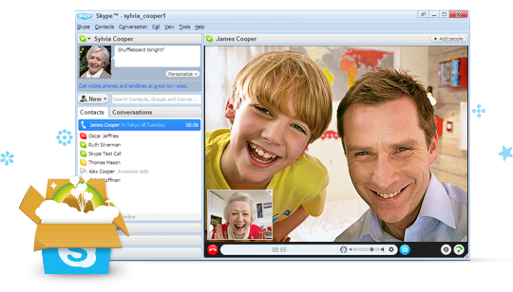
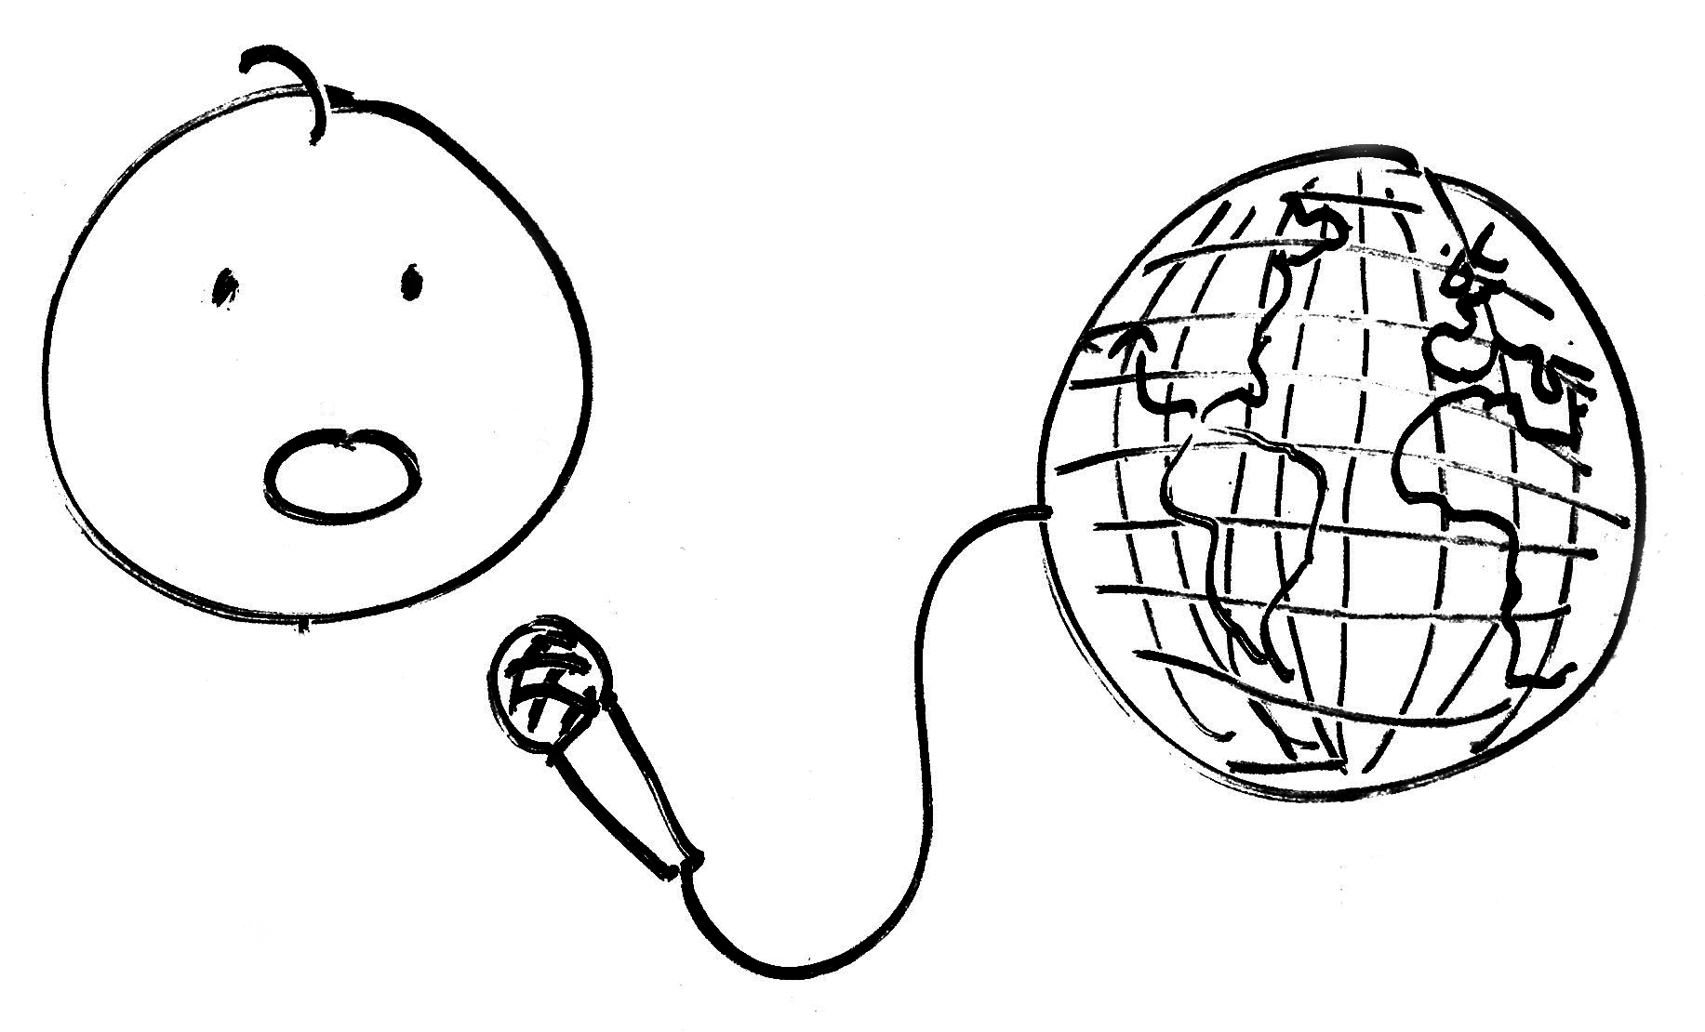
Asynchronous computer-mediated communication (ACMC)
Synchronous computer-mediated communication (SCMC)

Slide 3
My motivation
Improve speaking skills
Extra speaking opportunities
Increase confidence
Levy, M., & Stockwell, G. (2006)
Kervin, L., & Derewianka, B. (2011)

Slide 4
The task

Slide 5
myBrainshark
Free
Innovative (Burston, 2003; Tomlinson, 2003 Chapelle, 2010)
Very easy-to-use (Hubbard, 1996; Chapelle, 1998; Burston, 2003)
Authentic & sophisticated content (Burston, 2003; Reinders & White, 2010)
New type of activities (Reinders & White, 2010)
Ease of sharing (Reinders & White, 2010)

Slide 6
The task
The story of your life
Who are you? What’s your personality like?
Talk about your birthplace
Describe your family
Talk about your hobbies and likes/dislikes
Special moments in your life

Slide 7
Data collection
Quantitative methods
Questionnaire
Qualitative methods
Stimulated recall

Slide 8
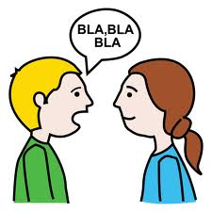
Attitudes towards speaking development
Overall speaking skills (93.8%)
Public speaking skills (75%)
Pronunciation (81.3%)
Fluency (93.8%)
Questionnaire findings

Slide 9
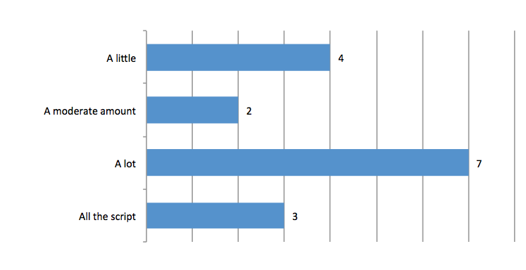
Interesting fact 1
The majority of students read aloud
Questionnaire findings

Slide 10
Interesting fact 2
Not as good as real conversation
I do think that the uhm the pressure that comes from a conversation in a foreign language isn’t really replicated by myBrainshark uhm I don’t think that that’s gonna come from it.
Student’s reflection

Slide 11
Interesting fact 1

Slide 12
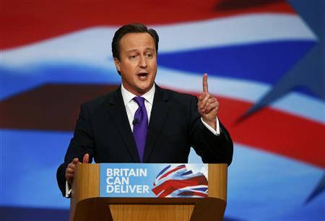
Reading
Coslett, 1991; Schwartz et al. 1980.
Semantic reading
Non-semantic reading

Slide 13
Reading aloud (non-semantically)
Greater focus on phonological awareness
Fluency (Gibson, 2008)
Consolidate newly acquired speech patterns (Chun, 2002)
Intonation (Davis & Rinvolucri, 1988)
Pronunciation (Ortiz et al. 2010)
Rhythm (Ortiz et al. 2010)
Speed (Ortiz et al. 2010)

Slide 14
Language-learning processes
Use of diverse tools
Planning what to say
Writing text down
Reading aloud
Rehearsing elocution
Listening to one’s recording
Questionnaire findings

Slide 15
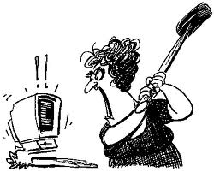
Interesting fact 2
Not as good as real conversation
Notes:
The lack of ACMC face-to-face interactions

Slide 16
Fact 2
External pressures
Turn-allocational techniques
Interlocutors that occupy the same time frame within a turn
Fight for the floor of conversation

Slide 17
Fact 2
Adopt the right lens
Increase speaking proficiency
Help understand how to use language in authentic contexts
Serve as a preliminary stepping-stone towards real communication
Build up confidence

Slide 18
Increase of confidence
I think in terms of confidence [the activity] helps a lot because, the main problem, or I, I found was sort of trying to speak it because in class there are other people in class that are much, much sort of, have they accent a bit more perfect and things like that so it might put you off a little bit from speaking out loud all the time. Erm, so, by speaking on the computer the teacher can hear it himself, then that helps a lot.
Student’s reflection

Slide 19
Conclusions
ACMC as suitable to enhance speaking skills
ACMC is not the panacea
myBrainshark is just a tool
ACMC as a process

Slide 20
Task with technology
Task
Educator
Tech
Impact

Slide 21
Questions?
Nicolás Pino James
n.pino-james@warwick.ac.uk
Centre for Applied Linguistics
University of Warwick

Slide 22
References
Briz, A. (2000). Turno y alternancia de turno en la conversación. Revista Argentina de Lingüística, 16, 9-32.
Burston, J. (2003). Software selection: A primer on sources and evaluation. CALICO Journal, 21(1), 29-40.
Chapelle, C. (1998). Multimedia CALL: Lessons to be learned from research on instructed SLA. Language Learning & Technology, 2(1), 22-34.
Chapelle, C. (2010). The spread of computer-assisted language learning. Language Teaching, 43(01), 66-74.
Chun, D. (2002). Discourse Intonation in L2; from Theory to Practice. Amsterdam and Philadelphia: John Benjamins Publishing Company.
Coslett, H. (1991). Read but not write “idea”: Evidence for third reading mechanism. Brain & Language, 40, 425-443.
Davis, P., & Rinvolucri, M. (1988). Dictation: New Methods, New Possibilities. Cambridge: Cambridge University Press.
Gibson, S. (2008). Reading aloud: A useful learning tool? ELT Journal, 62(1), 29-36.

Slide 23
References
Hubbard, P. (1996). Elements of CALL methodology: Development, evaluation, and implementation. In Pennington, M. (Ed.), The Power of CALL (pp. 335-355). Houston: Athelstan.
Kervin, L., & Derewianka, B. (2011). New technologies to support language learning. In B. Tomlinson (Ed.), Materials development in language teaching (pp. 328-51). Cambridge: Cambridge University Press.
Levy, M., & Stockwell, G. (2006). Computer-Mediated Communication. In M. Levy and Stockwell, G. (Eds.), CALL Dimensions: Options and Issues in Computer Assisted Language Learning (pp. 84-109). Mahwah, NJ: Lawrence Erlbaum Associates.
Ortiz, P., Paín, M., García, M., & Rey, L. (2010). Self-training in reading aloud through ICT. In ICT for language learning conference proceedings 2010. Italy: Simonelli Editore.
Reinders, H., & White, C. (2010). The theory and practice of technology in materials development and task design. In N. Harwood (Ed.), Materials in ELT: Theory and practice (pp. 58-80). Cambridge: Cambridge University Press.
Schegloff, E. (2000). Overlapping talk and the organization of turn-taking for conversation, Language in Society, 29, 1-63.
Schwartz, M., Saffran, E., & Marin, O. (1980). Fractionating the reading process in dementia: Evidence for word-specific print-to-sound associations. In M. Coltheart, K. E. Patterson, & J. C. Marshall (Eds.), Deep Dyslexia (pp. 259-269). London: Routledge.

